Slide 1

“The Kitchen Closet” Network Plan for Food Pantry nonprofit
Drew Roberts
Michael Dunne Jonah Mckitty

Slide 2
What is “The Kitchen Closet?”
“The Kitchen Closet is a nonprofit Food Pantry dedicated to assisting local meal programs to coordinate and distribute food to those in need within the local community
The primary purpose of the organization is to act as a middleman to assist local Food Banks to distribute to local meal programs, soup kitchen, homeless shelters etc.
Funding for the organization will be through State Grants, donations and fundraising
Consisting of a Staff of 5 Full time employee’s including the director, 4 partime employees and roughly 35 volunteers. A small portion of this staff will be technical

Slide 3
Network Plan (Staff)
Staff wise: One of the full-time employees will need to be the dedicated on-site IT support.
After initial setup, they will only need to maintain the established network, through some AD administration training and basic system and network administration.
To aid in this, It is recommended that two of the available volunteer spots be allocated for the local university’s IT program as part of an Internship opportunity for budding IT professionals about to graduate from their program, to assist with IT Support
Should further IT assistance be required, the organization can reach out to local IT services and contract them as needed

Slide 4
Network Plan (Hardware)
We will be repurposing all the desktops and monitors that were left in the office space, we will be properly disposing of the old hard drives, purchasing new ones, along with Windows Desktop and Windows Server Licenses (At discount prices courtesy of Techsoup.com offering lower prices for NPOs)
5 desktops repurposed as personal workstations for the FTEs
8 desktops will be repurposed for a Hoteling Cube farm, where the part time employees and volunteers will use them as needed (for printing, writing up documents checking email etc)
4 of the remaining machines will be repurposed to setup the Active directory domain of the nonprofit, consisting of 2 Domain Controllers and 2 DNS servers. 2 of each for redundancy. Managing the organization via Active Directory will make sure that only the correct people have the proper permissions to access what they need for their work in the NPO
The final Desktop will be repurposed into the File server to handle all file and database sharing services required for the organization. This server will be outfitted with a Raid 5 setup.
We will be purchasing 2 printers to be placed on the domain, 1 for use by the FTEs and 1 for use by the Hoteling Cube farm
The network gear will consist of: 1 Cisco Router between the domain and the Demarcation point with the ISP we’ve chosen (Verizon), a 24 port Switch to run ethernet cable to all existing devices on the domain, A firewall for security and Eero Pods for wireless internet, should volunteers want to bring laptops for their work.
Staff and volunteers will be expected to have access to Smartphones. The FTEs will receive a stipend as part of their salary for phone usage.

Slide 5
Network Security
We chose to do an active directory for our non-profit based on Drew's prior experience on non-profits job sites.
The reasoning is, permission can be given and taken on a need to have /use bases if it needed to be changed on the fly for one person or another it can be done so within seconds for multiple users

Slide 6
Network Plan(Budget)
Hardware | Price | Amount | Total
PNY CS900 500GB Solid State Hard drives | $29 | 13 | $377
Windows 11 Pro Operating System | $16 | 13 | $208
Western Digital Red Plus hard drives | $75 | 3 | $225
Windows Server 2019 Licenses | $106 | 5 | $530
Business Grade HP Laser Jet | $389 | 2 | $778
Cisco Meraki Z4 Teleworker Gateway | $379 | 1 | $379
NETGEAR 24-Port Gigabit Ethernet Unmanaged Switch | $90 | 1 | $90
Cisco Meraki MX67 Security Appliance | $543 | 1 | $543
Eero pods 3 pack eero pro 6e 6,000 sqr ft | $349 | 1 | $349
Ethernet cat 6 cable roll 1000 ft. | $284 | 1 | $284
8 pin connectors for Ethernet 100 count lot | $10 | 1 | $10
 |  | Total | $3,159
Monthly Service Costs
Product | Price | Amount | Total
M365 | $23 | 13 | $299
Ink Refill Prog. | $50 | 1 | $50
Verizon Small Biz Internet | $99 | 1 | $99
 |  | Total | $448

Slide 7
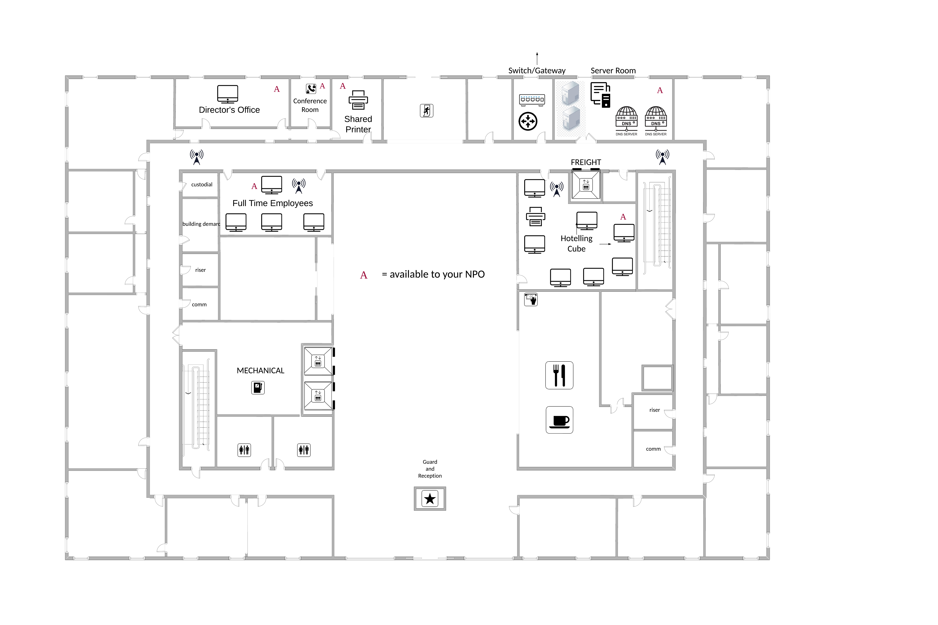
Floor Plan

Slide 8
The end
Questions???

